Slide 1


PRR & VS GOVT COLLEGE
VIDAVALUR

Slide 2


Slide 3
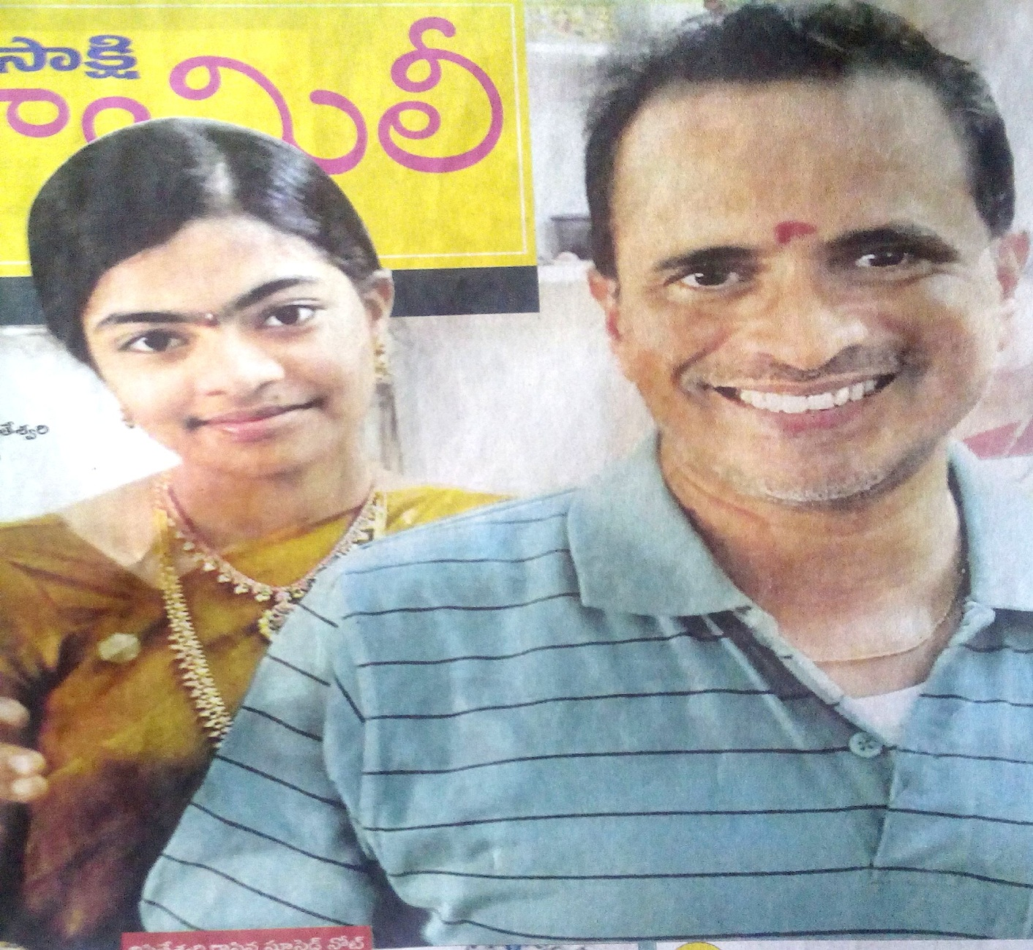

Slide 4


Slide 5
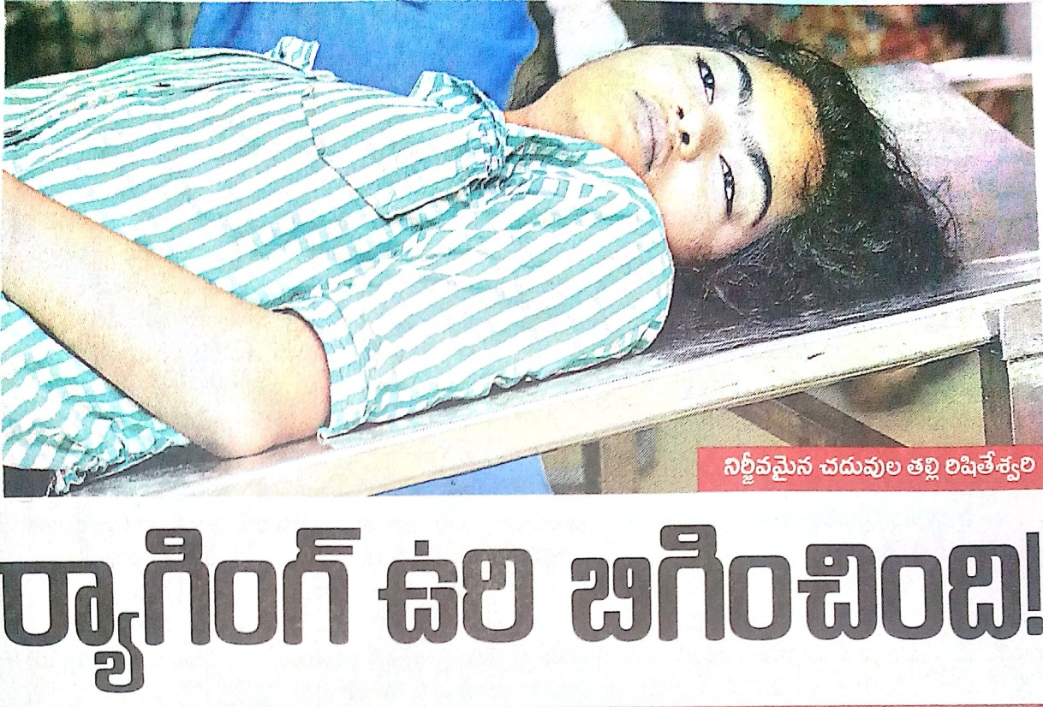

Slide 6
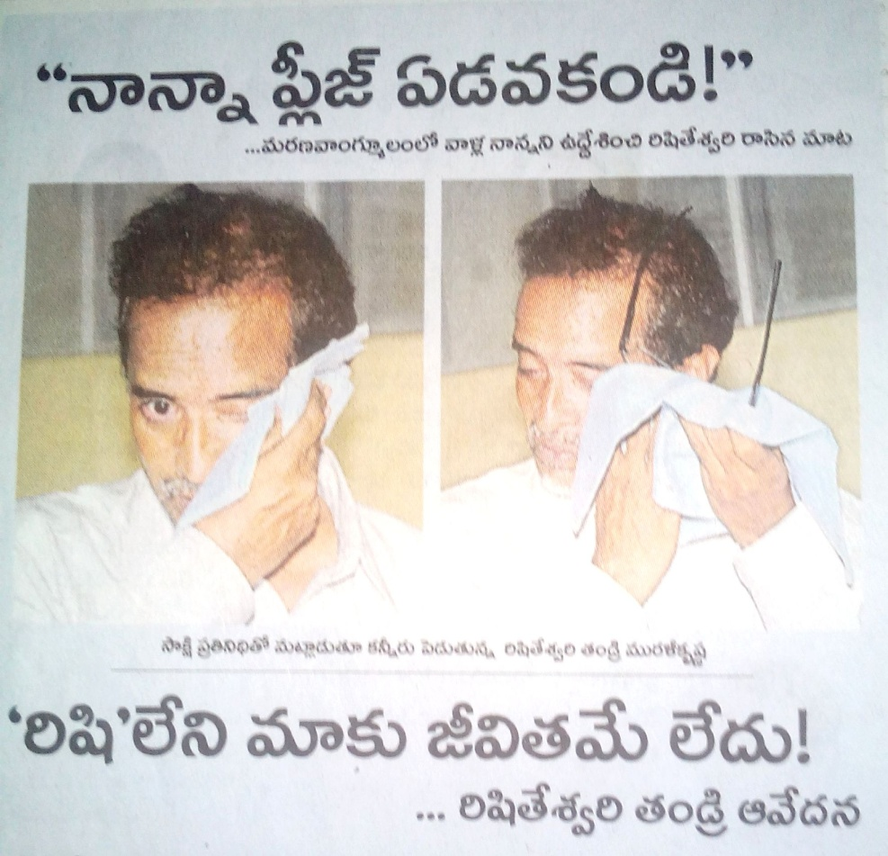

Slide 8


Slide 10


Slide 11


Slide 12


Slide 13


Slide 14


Slide 15


Slide 16


Slide 17


Slide 18
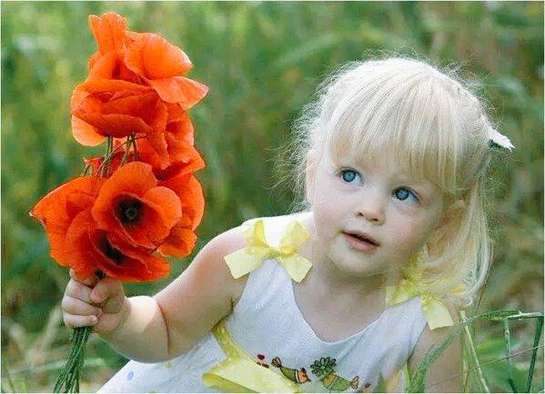
PLEASE SAY NO TO RAGGING

Slide 19

THANK YOU

